Slide 1
Principal Component Analysis (PCA)

Slide 2
Why Principal Component Analysis?
We have too many dimensions in the data sets which make difficulty to obtain insights, and visualize
We need to reduce them to a smaller set of dimensions to represent data in better way without losing much information
The reduced data sets can build more effective data analyses (such as, classification, clustering, pattern recognition) on the reduced-dimensional space

Slide 3
Principal Component Analysis
PCA discovers a new set of dimensions/axes against which to represent, describe or evaluate the data
For more effective reasoning, insights, or better visualization
Reduce noise in the data
Better representation of data without losing much information
Can build more effective data analyses on the reduced-dimensional space: classification, clustering, pattern recognition

Slide 4
Principal Component Analysis
PCA discovers a new set of dimensions by the combinations of observed variables which may be more effective bases for insights, even if physical meaning is obscure
Observed data are described in terms of these new dimensions rather than in terms of original variables/dimensions

Slide 5
Basic Concept : PCA
If two dimensions are highly correlated or dependent, combining them to form a single measure is reasonable
So we want to combine related variables, and focus on uncorrelated or independent variables, especially those along which the observations have high variance
We want a smaller set of variables that explain most of the variance in the original data, in more compact and insightful form

Slide 6
Principal Component Analysis (PCA)
The new variables/dimensions
Are linear combinations of the original ones
Are uncorrelated with one another
Orthogonal in original dimension space
Capture as much of the original variance in the data as possible
Are called Principal Components

Slide 7
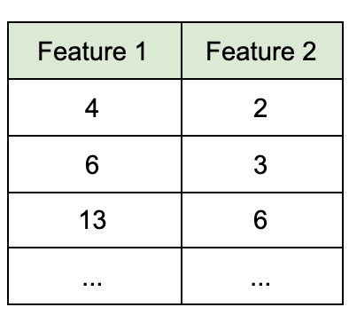
Principal Component Analysis (PCA)
PCA is one of the most commonly used unsupervised machine learning algorithms used for dimensionality reduction
Imagine we have a 2-dimensional dataset. Each dimension can be represented as a feature column:

Slide 8
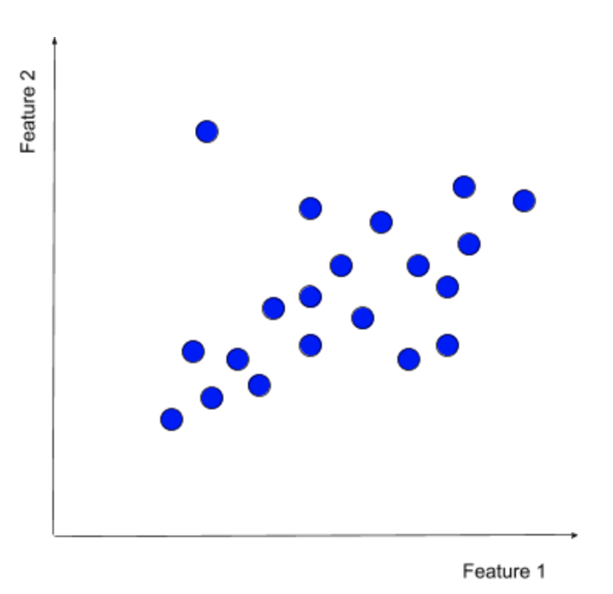
Principal Component Analysis (PCA)
We can represent the same dataset as a scatterplot:

Slide 9
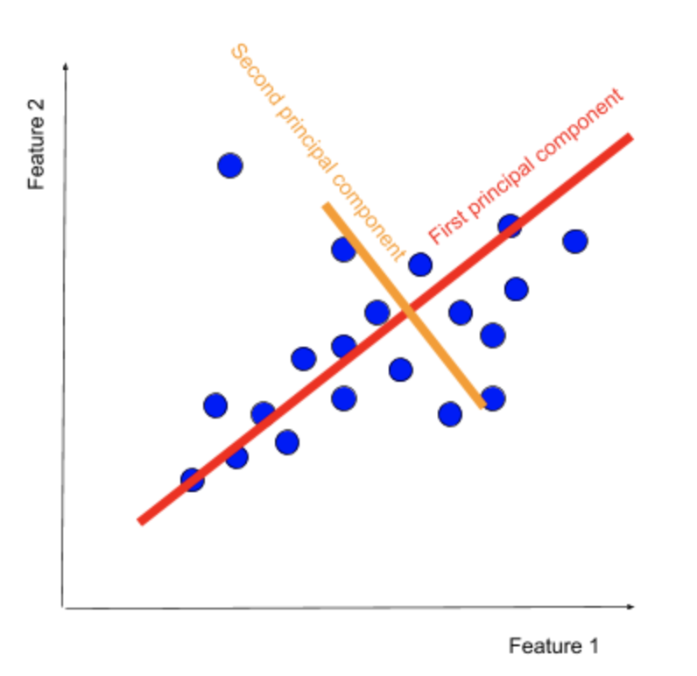
Principal Component Analysis (PCA)
The main aim of PCA is to find such principal components, which can describe the data points with these set of principal components.

Slide 10
Principal Component Analysis (PCA)
The principal components are vectors, but they are not chosen at random.
The first principal component (PCA1) is computed so that it explains the greatest amount of variance in the original features.
The second component (PCA2) is orthogonal to the first, and it explains the greatest amount of variance left after the first principal component.

Slide 11
Principal Component Analysis (PCA)
The original data can be represented as feature vectors.
Getting principal components is equivalent to a linear transformation of data from the feature1 x feature2 axis to a PCA1 x PCA2 axis.

Slide 12
Principal Component Analysis (PCA)
Why is this useful?
In the small 2-dimensional example above, we do not gain much by using PCA, since a feature vector of the form (feature1, feature2) will be very similar to a vector of the form (PCA1, PCA2).
But in very large datasets (where the number of dimensions can surpass 100 different variables), principal components remove noise by reducing a large number of features to just a couple of principal components.
Principal components are orthogonal projections of data onto lower-dimensional space.

Slide 13
Principal Component Analysis (PCA)
In theory, PCA produces the same number of principal components as there are features in the training dataset.
But, in practice, we do not keep all of the principal components.
Each successive principal component explains the variance that is left after its preceding component.
So picking just a few of the first components sufficiently approximates the original dataset without the need for additional features.
The result is a new set of features in the form of principal components, which have multiple practical applications.

Slide 14
Principal Component Analysis (PCA)
How is PCA calculated?
There are multiple ways to calculate PCA:
i) Eigendecomposition of the covariance matrix
ii) Singular value decomposition of the data matrix
iii) Eigenvalue approximation via power iterative computation
iv) Non-linear iterative partial least squares (NIPALS) computation
v) … and more.

Slide 15
PCA: Eigendecomposition of the covariance matrix
There are several steps in computing PCA
i) Feature standardization
ii) Covariance matrix computation
iii) Calculate the eigendecomposition of the covariance matrix
iv) Sort the eigenvectors from the highest eigenvalue to the lowest
v) Select the number of principal components
vi) Recast the data along the principal components axes

Slide 16
PCA: Eigendecomposition of the covariance matrix
i) Feature standardization:
- The range of variables is calculated and standarized in this process to analyze the contribution of each variable equally
- To transform the variables of the same standard, we may use the Z-score formula.

Slide 17

Feature standardization
Let us consider the following dataset and apply Z-score standarization formula:
Calculate mean and
standard deviation for each feature:
Object | F1 | F2 | F3 | F4
O1 | 1 | 5 | 3 | 1
O2 | 4 | 2 | 6 | 3
O3 | 1 | 4 | 3 | 2
O4 | 4 | 4 | 1 | 1
O5 | 5 | 5 | 2 | 3
 | F1 | F2 | F3 | F4
Mean | 3 | 4 | 3 | 2
Standard Deviation | 1.87 | 1.223 | 1.87 | 1

Slide 18
Feature standardization
After the standarization of each variable, the resultant data set is:
Object | F1 | F2 | F3 | F4
O1 | -1.0695 | 0.8196 | 0 | -1
O2 | 0.5347 | -1.6393 | 1.6042 | 1
O3 | -1.0695 | 0 | 0 | 0
O4 | 0.5347 | 0 | -1.0695 | -1
O5 | 1.0695 | 0.8196 | -0.5347 | 1

Slide 19
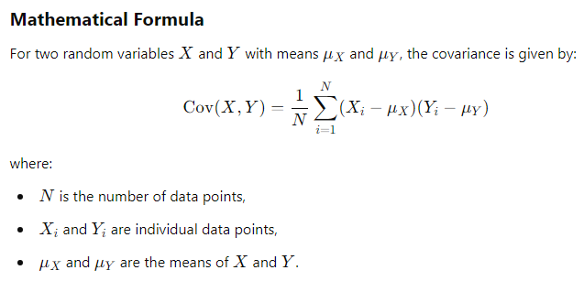
Eigendecomposition of the covariance matrix
ii) Covariance matrix computation:
Covariance is a statistical measure that quantifies the degree to which two variables change together. It indicates whether an increase in one variable corresponds to an increase or decrease in another variable.

Slide 20
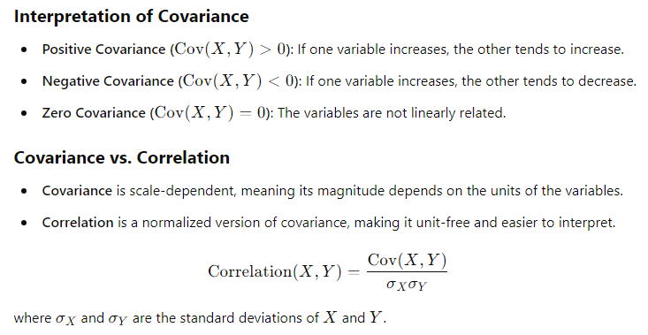
Covariance matrix computation

Slide 21
Covariance matrix computation
In this step, we shall get to know how the variables of the given data are varying with the mean value calculated.
Any interrelated variables can also be sorted out at the end of this step.
To segregate the highly interrelated variables, we calculate the covariance matrix with the help of the given formula.
The covariance matrix is a square matrix, of d x d dimensions, where d stands for “dimension” or feature
It contains the covariances of all possible data sets.
It shows the pair wise feature correlation between each feature.

Slide 22


Covariance matrix computation
The covariance matrix of two-dimensional data is, given as follows:
, where
for n objects.
Note that, COV(X, X)=Var(X), so the values at the top left and bottom right will have the variances of the same initial number.

Slide 23
Covariance matrix computation
The Covariance Matrix (CM) is symmetric, as COV(X, Y)=COV(Y, X).
If the value of the CM is positive, then it indicates that the variables are correlated (i.e., if X increases, Y also increases and vice versa)
If the value of the CM is negative, then it indicates that the variables are inversely correlated (i.e., if X increases, Y decreases and vice versa).

Slide 24
Covariance matrix computation
As a result, at the end of this step, we may come to know which pair of variables are correlated with each other, so that we might categorize them much easier.
Example: Continuing with the same example, we have to compute CM as:
 | F1 | F2 | F3 | F4
F1 | VAR(F1) | COV(F1, F2) | COV(F1, F3) | COV(F1, F4)
F2 | COV(F2, F1) | VAR(F2) | COV(F2, F3) | COV(F2, F4)
F3 | COV(F3, F1) | COV(F3, F2) | VAR(F3) | COV(F3, F4)
F4 | COV(F4, F1) | COV(F4, F2) | COV(F4, F3) | VAR(F4)

Slide 25
Covariance matrix computation
Since we have already standardized the features, we can consider Mean = 0 and Standard Deviation=1 for each feature.
VAR(F1) = ((-1.0695-0)² + (0.5347-0)² + (-1.0695-0)² + (0.5347–0)² +(1.069–0)²)/5 = 0.78
COV(F1,F2) = ((-1.0695–0)(0.8196-0) + (0.5347–0)(-1.6393-0) + (-1.0695–0)(0.0000-0) + (0.5347–0)(0.0000-0)+ (1.0695 –0) (0.8196–0))/5 = -0.8586

Slide 26
Covariance matrix computation
Similarly solving all the features, the covariance matrix will be:
 | F1 | F2 | F3 | F4
F1 | 0.78 | -0.8586 | -0.055 | 0.424
F2 | -0.8586 | 0.78 | -0.607 | -0.326
F3 | -0.055 | -0.607 | 0.78 | 0.426
F4 | 0.424 | -0.326 | 0.426 | 0.78

Slide 27
Eigendecomposition of the covariance matrix
iii) Calculate the eigendecomposition of the covariance matrix
We calculate the eigenvectors (unit vectors) and their associated eigenvalues (scalars by which we multiply the eigenvector) of the covariance matrix.
The eigenvectors of the covariance matrix play a crucial role in understanding the structure and behavior of data in high-dimensional spaces.
They provide insights into the underlying relationships, directions of variance, and dimensionality of the data.

Slide 28
iii) Calculate the eigendecomposition
Some key significances are:
1. Directions of Maximum Variance
- Each eigenvector represents a principal direction in which the data varies the most.
- The eigenvectors indicate the axes along which the data is spread in the feature space.
- For example, if a dataset has two strongly correlated features, the first eigenvector will point in the direction of the greatest variance.

Slide 29
iii) Calculate the eigendecomposition
2. Feature Decorrelation
The eigenvectors are orthogonal (perpendicular to each other), meaning they form a new set of uncorrelated axes.
Transforming the data into the eigenvector basis (e.g., via PCA) removes redundancy caused by correlations among the original features.
3. Dimensionality Reduction
The eigenvectors corresponding to the largest eigenvalues capture the most significant variance in the data.
In PCA, the data is projected onto these eigenvectors to reduce dimensionality while retaining as much variance as possible.
For example, keeping the top k eigenvectors (principal components) retains most of the data’s variability while discarding less informative directions.

Slide 30
iii) Calculate the eigendecomposition
4. Data Interpretation and Visualization
Eigenvectors provide interpretable directions in the feature space. For instance:
The first eigenvector (associated with the largest eigenvalue) identifies the direction of maximum spread in the data.
Subsequent eigenvectors represent orthogonal directions capturing decreasing amounts of variance.
5. Identifying Redundancy and Correlations
Eigenvectors reveal linear relationships or redundancy between features. For example:
If one eigenvalue is zero (or near-zero), it means the corresponding eigenvector points to a direction where the data has little or no spread, indicating possible redundancy or collinearity.
A small set of eigenvectors with large eigenvalues may explain most of the dataset's variance, while others may be noise.

Slide 31
iii) Calculate the eigendecomposition
6. Geometric and Statistical Significance
In the geometric sense, eigenvectors represent the axes of the ellipsoid that describes the covariance structure of the data in multidimensional space.
In statistics, eigenvectors indicate the principal modes of variation in the data, helping in understanding its overall distribution.

Slide 32
Calculate the eigendecomposition of the covariance matrix
To determine the principal components of variables, we have to define eigenvalue and eigenvectors of CM.
Let A (i.e., the covariance matrix CM) be any square matrix. A non-zero vector v having same direction as Av is an eigenvector of A if (A – λI)v = 0, i.e., Av = λv for some number λ, called the corresponding eigenvalue.
Once we have computed the eigenvalues, define eigenvalues in descending order ( for all variables) and now we will get a list of principal components.

Slide 33
Eigenvalues & eigenvectors
Av=λv ⇔ (A-λI)v=0
How to calculate v and λ:
Calculate det(A-λI), yields a polynomial (degree n)
Determine roots to det(A-λI)=0, roots are eigenvalues λ
Solve (A- λI)v=0 for each λ to obtain eigenvectors v

Slide 34
Eigenvalues & eigenvectors
To find the eigenvalues of a matrix, we solve the eigenvector equation:
Av=λv where: A is an n×n square matrix,
v is the eigenvector, and λ is the eigenvalue.
Steps to Find Eigenvalues:
Step 1: Rewrite the Eigenvector Equation
Rearrange the equation: Av−λIv=0
Factor out v: (A−λI)v=0 where I is the identity matrix.
Step 2: Solve the Characteristic Equation
For a non-trivial solution (v≠0), the determinant must be zero:
det⁡(A−λI)=0. This is called the characteristic equation.
Step 3: Find the Eigenvalues (λ)
Solve the determinant equation for λ. The solutions are the eigenvalues.

Slide 35
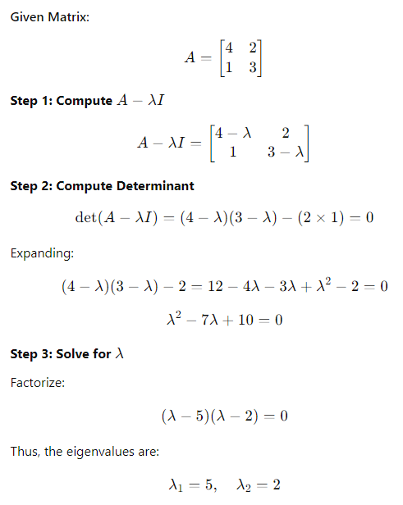
Example:Eigenvalues & eigenvectors

Slide 36
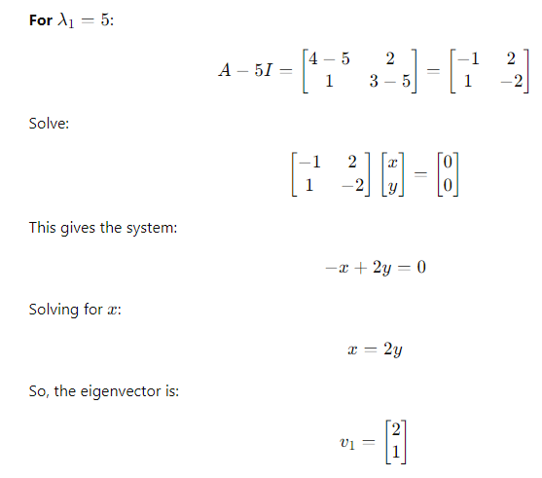
Example:Eigenvalues & eigenvectors
Compute eigenvector:

Slide 37
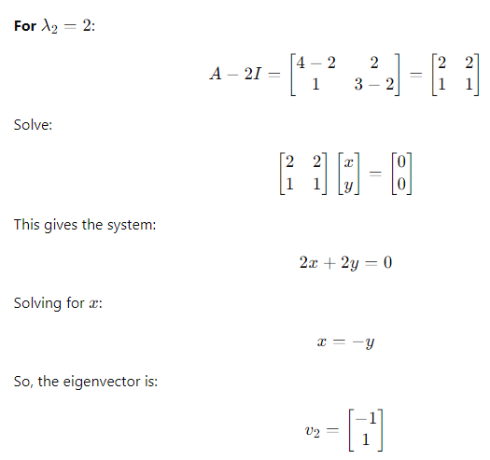
Example:Eigenvalues & eigenvectors
Compute eigenvector:

Slide 38
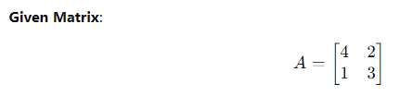
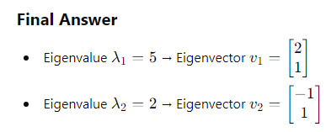
Example:Eigenvalues & eigenvectors
For very high-dimensional matrices, we use iterative numerical methods instead of solving the characteristic equation:
Power Iteration : For largest eigenvalue
Lanczos & Arnoldi Methods: For sparse matrices
QR Algorithm: For full eigenvalue decomposition, but expensive
Singular Value Decomposition(SVD): For more stable approximations

Slide 39
Calculate the eigendecomposition of the covariance matrix
So, the eigenvectors represent the principal components and these components represent the direction of data.
This indicates that if the line contains large observations of large variances, then there are many data points on the line. Thus, there is more information on the line too.
Finally, these principal components form a line of new axes for easier evaluation of data and also the differences between the observations can also be easily monitored.

Slide 40
Calculate the eigendecomposition of the covariance matrix
Example: Let ν be a non-zero vector and λ a scalar.
As per the rule, Aν = λν, then λ is called eigenvalue associated with eigenvector ν of A.
Upon substituting the values in det(A- λI) = 0, we will get the following matrix.

Slide 41
Calculate the eigendecomposition of the covariance matrix
 | F1 | F2 | F3 | F4
F1 | 0.78 - λ | -0.8586 | -0.055 | 0.424
F2 | -0.8586 | 0.78 - λ | -0.607 | -0.326
F3 | -0.055 | -0.607 | 0.78 - λ | 0.426
F4 | 0.424 | -0.326 | 0.426 | 0.78 - λ
When we solve the following matrix by considering 0 on right-hand side, we can define eigenvalues as
λ = 2.11691, 0.855413, 0.481689, and 0.334007
We may use root finding algorithms like Bisection Method, Regula Falsi, Newton-Raphson Method, etc
Then, substitute each eigenvalue in (A-λI)ν=0 and solve the same for different eigenvectors v1, v2, v3 and v4.

Slide 42
Calculate the eigendecomposition of the covariance matrix
For instance, for λ = 2.11691, solving the above equation using Cramer's rule, the eigenvector obtained are: v1 = 0.515514 v2 = -0.616625 v3 = 0.399314 v4 = 0.441098
Following the same process, we will get the eigenvectors for all eigenvalues.

Slide 43
Calculate the eigendecomposition of the covariance matrix
E1 | E2 | E3 | E4
0.515514 | -0.623012 | 0.0349815 | -0.587262
-0.616625 | 0.113105 | 0.452326 | -0.634336
0.399314 | 0.744256 | -0.280906 | -0.455767
0.441098 | 0.212477 | 0.845736 | 0.212173

Slide 44
Eigendecomposition of the covariance matrix
iv) Sort the eigenvectors from the highest eigenvalue to the lowest.
The eigenvector with the highest eigenvalue is the first principal component.
Higher eigenvalues correspond to greater amounts of shared variance explained.

Slide 45
Principal components
1. principal component (PC1)
The eigenvalue with the largest absolute value will indicate that the data have the largest variance along its eigenvector, the direction along which there is greatest variation
2. principal component (PC2)
The direction with maximum variation left in data, orthogonal to the PC1
In general, only few directions manage to capture most of the variability in the data.

Slide 46
Principal components
The first PC retains the greatest amount of variation in the sample
The k^{th} PC retains the k^{th} greatest fraction of the variation in the sample
The k^{th} largest eigenvalue of the correlation matrix C is the variance in the sample along the k^{th} PC

Slide 47
How Many PCs?
For n original dimensions, correlation matrix is nxn, and has up to n eigenvectors. So n PCs.
Where does dimensionality reduction come from?

Slide 48
Dimensionality Reduction
Can ignore the components of lesser significance.
You do lose some information, but if the eigenvalues are small, you don’t lose much
n dimensions in original data
calculate n eigenvectors and eigenvalues
choose only the first p eigenvectors, based on their eigenvalues
final data set has only p dimensions

Slide 49
Eigendecomposition of the covariance matrix
v) Select the number of principal components:
- Select the top N eigenvectors (based on their eigenvalues) to become the N principal components.
- The optimal number of principal components is both subjective and problem-dependent.
- Usually, we look at the cumulative amount of shared variance explained by the combination of principal components and pick that number of components, which still significantly explains the shared variance.

Slide 50
Calculate the eigendecomposition of the covariance matrix
The principal components are:
E1 | E3
0.515514 | 0.0349815
-0.616625 | 0.452326
0.399314 | -0.280906
0.441098 | 0.845736

Slide 51
RECAST THE DATA ALONG THE PRINCIPAL COMPONENTS AXES
Still now, apart from standardization, we haven’t made any changes to the original data.
You have just selected the Principal components and formed a feature vector.
Yet, the initial data remains the same on their original axes.
This step aims at the reorientation of data from their original axes to the ones we have calculated from the Principal components.

Slide 52
RECAST THE DATA ALONG THE PRINCIPAL COMPONENTS AXES
This can be done by the formula:
Final Data Set= Standardized Original Data Set * FeatureVector
By solving the above equations, we will get the
transformed data =
*
Object | F1 | F2 | F3 | F4
O1 | -1.0695 | 0.8196 | 0 | -1
O2 | 0.5347 | -1.6393 | 1.6042 | 1
O3 | -1.0695 | 0 | 0 | 0
O4 | 0.5347 | 0 | -1.0695 | -1
O5 | 1.0695 | 0.8196 | -0.5347 | 1
E1 | E3
0.515514 | 0.0349815
-0.616625 | 0.452326
0.399314 | -0.280906
0.441098 | 0.845736
F1 | F3
0.4268 | 0.00116
-0.4235 | -0.39182
-0.5513 | -0.79592
0.4652 | 0.89996
0.0827 | 0.28653

Slide 53
Advantages of PCA
i) Easy to compute. PCA is based on linear algebra, which is computationally easy to solve by computers.
ii) Speeds up other machine learning algorithms. Machine learning algorithms converge faster when trained on principal components instead of the original dataset.
iii) Counteracts the issues of high-dimensional data. High-dimensional data causes regression-based algorithms to overfit easily. By using PCA beforehand to lower the dimensions of the training dataset, we prevent the predictive algorithms from overfitting.

Slide 54
Disadvantages of PCA
Low interpretability of principal components: Principal components are linear combinations of the features from the original data, but they are not as easy to interpret. For example, it is difficult to tell which are the most important features in the dataset after computing principal components.
The trade-off between information loss and dimensionality reduction: Although dimensionality reduction is useful, it comes at a cost. Information loss is a necessary part of PCA. Balancing the trade-off between dimensionality reduction and information loss is unfortunately a necessary compromise that we have to make when using PCA.

Slide 55
Assumptions and limitations of PCA
PCA is related to the set of operations in the Pearson correlation, so it inherits similar assumptions and limitations:
PCA assumes a correlation between features. If the features are not correlated, PCA will be unable to determine principal components.
PCA is sensitive to the scale of the features. Imagine we have two features - one takes values between 0 and 1000, while the other takes values between 0 and 1. PCA will be extremely biased towards the first feature being the first principle component, regardless of the actual maximum variance within the data. This is why it’s so important to standardize the values first.

Slide 56
Assumptions and limitations of PCA
iii) PCA is not robust against outliers. Similar to the point above, the algorithm will be biased in datasets with strong outliers. This is why it is recommended to remove outliers before performing PCA.
iv) PCA assumes a linear relationship between features. The algorithm is not well suited to capturing non-linear relationships. That’s why it’s advised to turn non-linear features or relationships between features into linear, using the standard methods such as log transforms.
v) If the feature set has missing values, be sure to remove those rows and/or columns with missing values, or impute missing values.

Slide 57
Thank You

